Slide 1



CUSTOMER CHURN ANALYST
Lê Ngọc Khoa

Slide 2
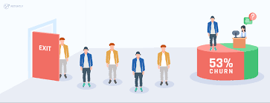
Customer churn
This concept refers to a situation in which customers leave and stop using a company's product or service for a period of time. Usually, the company will measure and analyze to evaluate the effectiveness of its business and marketing strategy based on this indicator
2

Slide 3






TABLE OF CONTENTS
01
DATASET
02
DATA
03
EDA
DISCOVERY
PREPROCESSING
04
05
06
FEATURE
BULDING AND TRAING MODEL
FEATURE IMPORTANCE
SOLUTION
ENGINEERING

Slide 4

DATASET
DISCOVERY
01

Slide 5
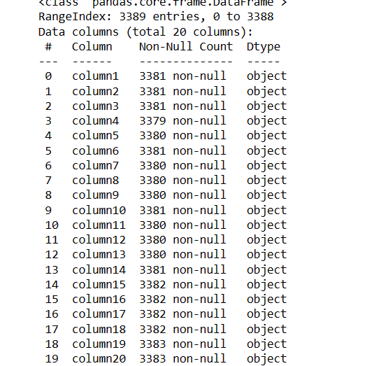
ABOUT DATASET
The dataset with 3388 records and 20 contributors

Slide 6
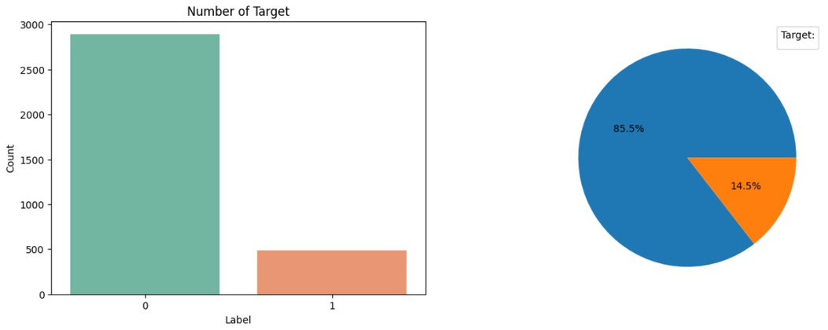
TARGET VARIANCE
The churn variable will be our target variable with two values of 0 and 1 representing the group of customers who remain and the group of customers who have left, respectively. Therefore, the initial orientation of the model in the article will be classification models.

Slide 7
DATA
PREPROCESSING
02

Slide 8
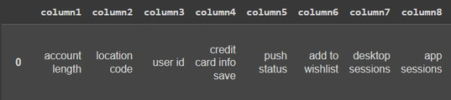
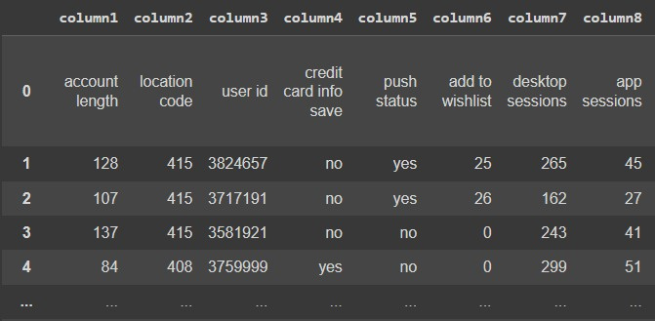
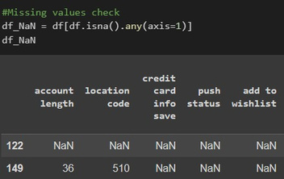
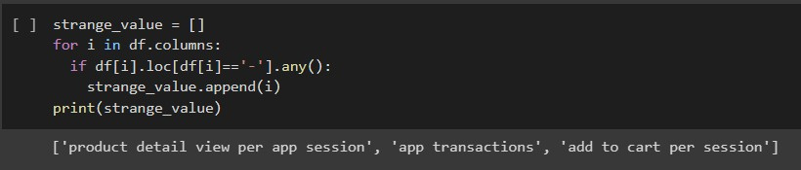
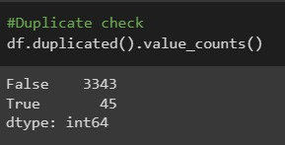

Slide 9
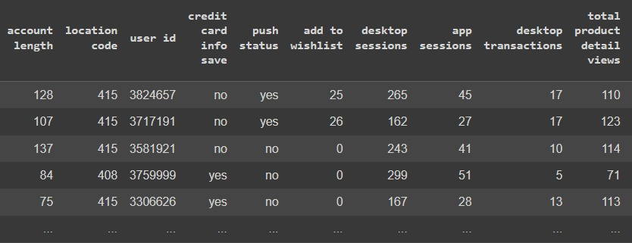


Slide 10
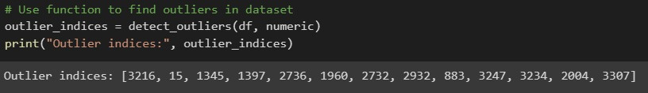

OUTLIER DETECTION
Using the interquartile range (IQR) to detect outliers in dataset

Slide 11
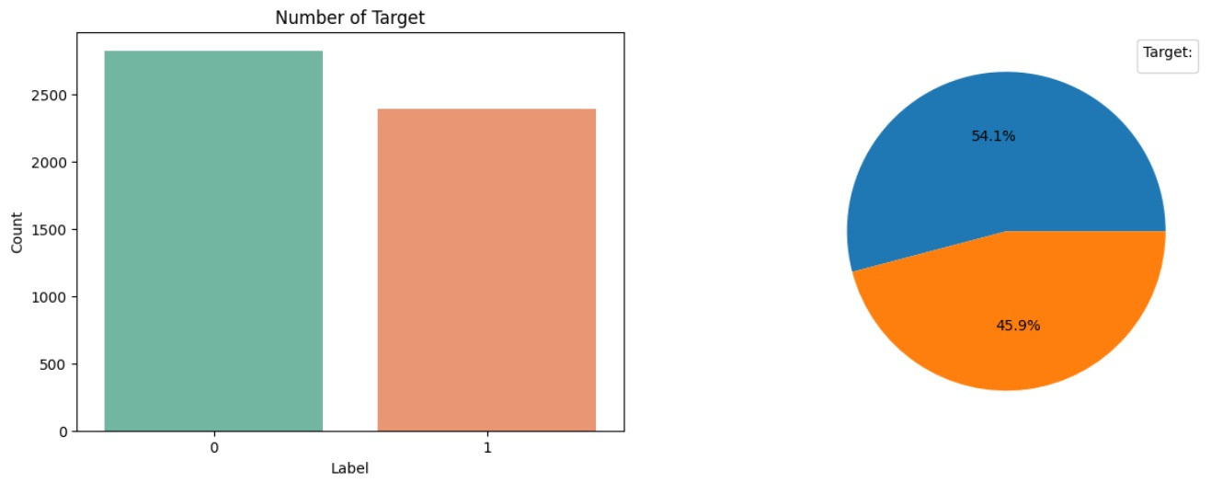
FIX TARGET BIAS

Slide 12
EDA
03

Slide 13
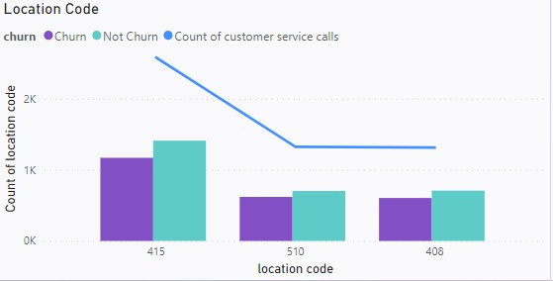
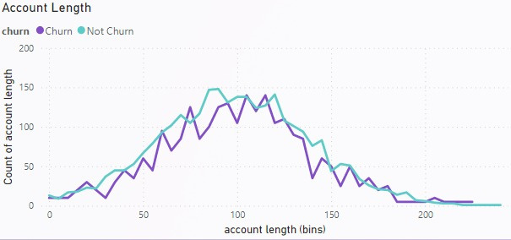
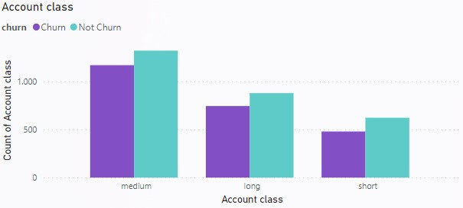
CONTEXT INFORMATION
Data is generated from concentration 3 main areas with the most in 415
The number of days members gather from 70 to 120
it can be seen that the data set gives a fair ratio of customer segments to demographics

Slide 14
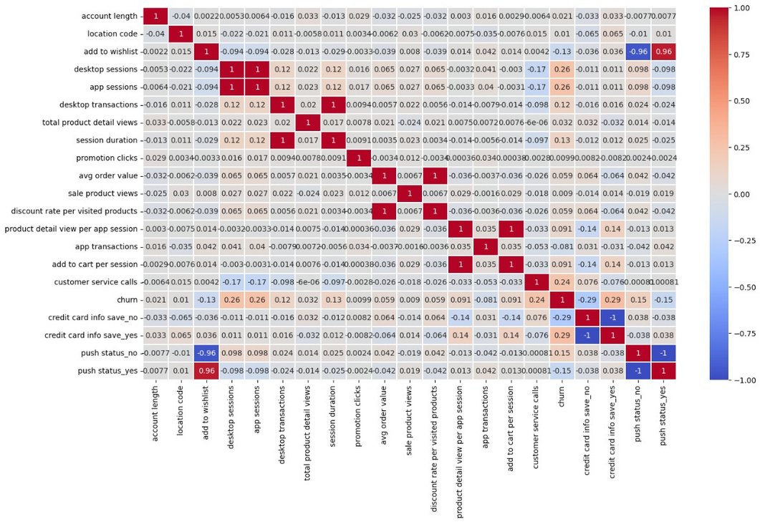



HEATMAP
App sessions
Desktop sessions
Session duration
Desktop transactions
Discount rate per visited products
Avg order value
Product detail view per app session
Add to cart per session

Slide 15
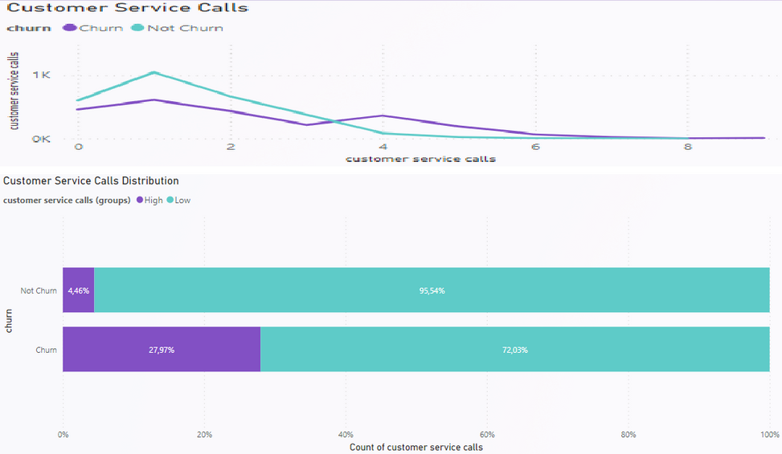
EFFECT OF CUSTOMER SERVICE CALLS ON CUSTOMER CHURN ABILITY
The customer not churn group has the highest frequency concentrated on calls 1 to 3.
The customer churn continues to contact the company for the 4th time or more, especially with the number of callers increasing from 4 to 8 times and accounts for nearly 23% of customers who have stopped shopping.

Slide 16
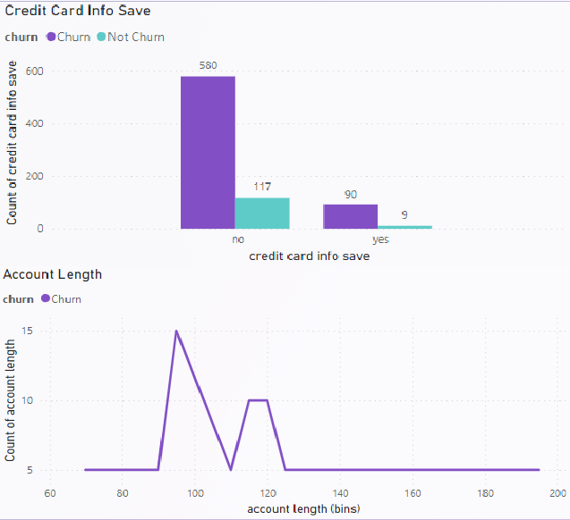
EFFECT OF CREDIT CARD INFO SAVE ON CUSTOMER CHURN ABILITY
The customer churn group accounted for 15% who saved credit card info, while about 7% in normal group.
The customer churn has 4+ support calls and saved credit card information, which is up to 90% higher in numbers than the other customer group and they are also medium lifetime members, suggesting these could be popular issues customer encounters related to the company's payment and credit regulations.

Slide 17
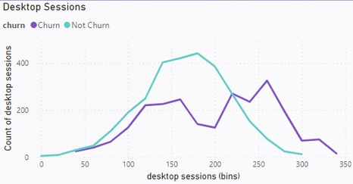
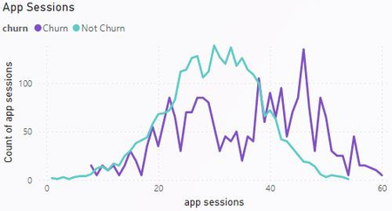
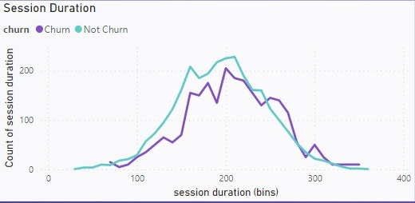
EFFECT OF DESKTOP AND APP SESSION ON CUSTOMER CHURN ABILITY
Customer churn group has amount of session 40% higher than normal
A large customer churn has more duration in a session for 260 seconds mark or more

Slide 18
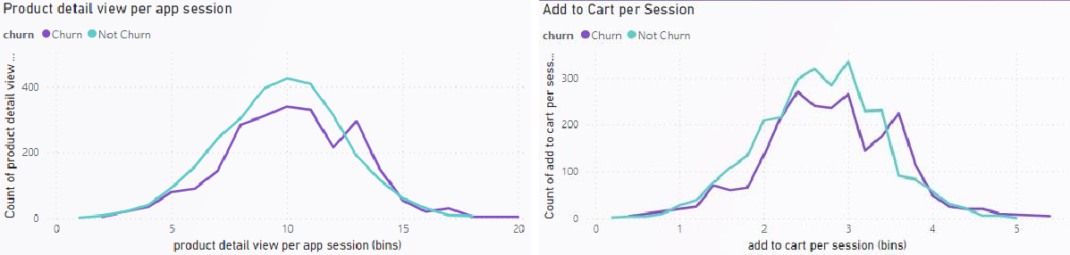
WHY DID CUSTOMERS CHURN GROUP HAS MORE DURATION AND ACCESS TIMES?
This shows that they are still hesitant before the decision to buy again but still regularly update information and promotions of the product to consider.

Slide 19
FEARTURE
ENGINEERING
04

Slide 20
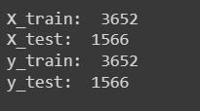
Featurescaling
Encode categorical features using the get_dummies function
Scale numerical features using the StandardScaler function
Split data into train set and test set
Split into 70-30 for train and test dataset

Slide 21
BUILD AND TRANING MODEL
05

Slide 22

CLASSIFICATION MODELS (Gridsearch CV)
Logistic Regression
Support Vector Classification
K-nearest neighbors
Decision Tree
Random forests

Slide 23
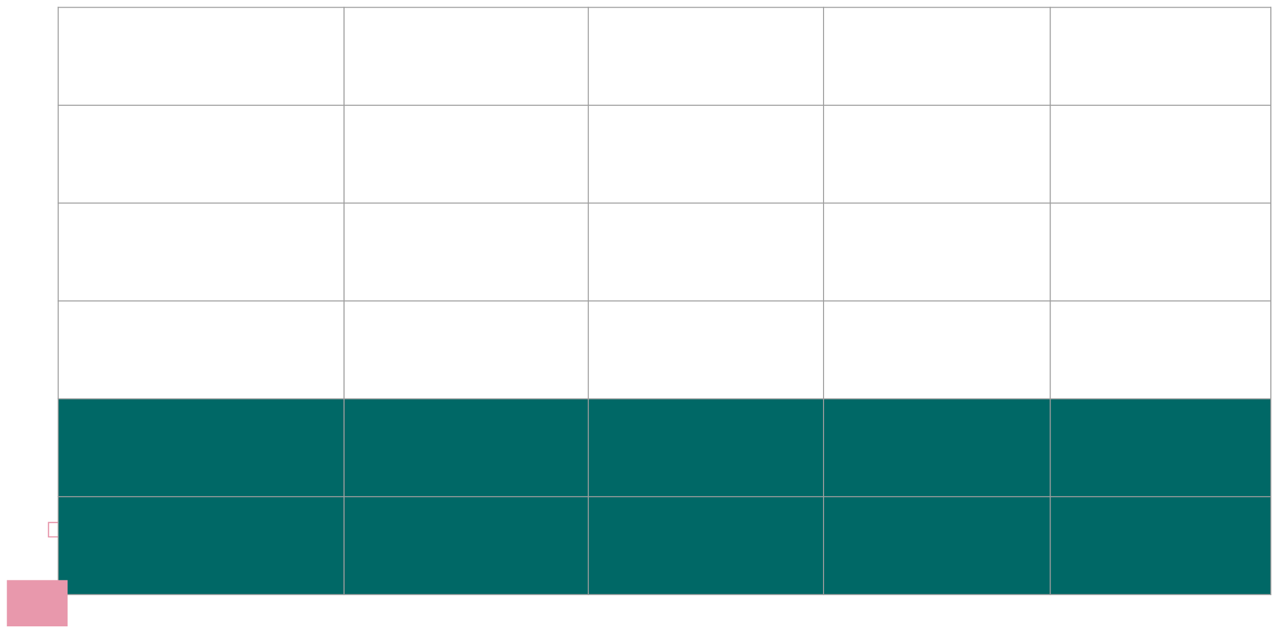
MODEL PERFORMANCE EVALUATION
Precision
0.76
0.91
0.92
0.92
0.97
Recal l
0.75
1.00
1.00
1.00
1.00
F1-score
0.75
0.95
0.96
0.96
0.99
Accuracy
0.78
0.95
0.96
Logistic Regression
Support Vector
Classification
K-nearest
neighbors
Decision
tree
Random
forests
0.96
0.99

Slide 24
MODEL PERFORMANCE EVALUATION
Decision tree
Top 2 performance model in the test
Higher performance as bringing out fast results and easier comprehensiveness by business A little chance to give out bad results that can affect the decision
Random forests
Top 1 performance model in the test
Need more time and resources to build and maintain in order to give out better result Higher reliability as basing on average result to determine the final

Slide 25
FEATURE
IMPORTANCE
06

Slide 26
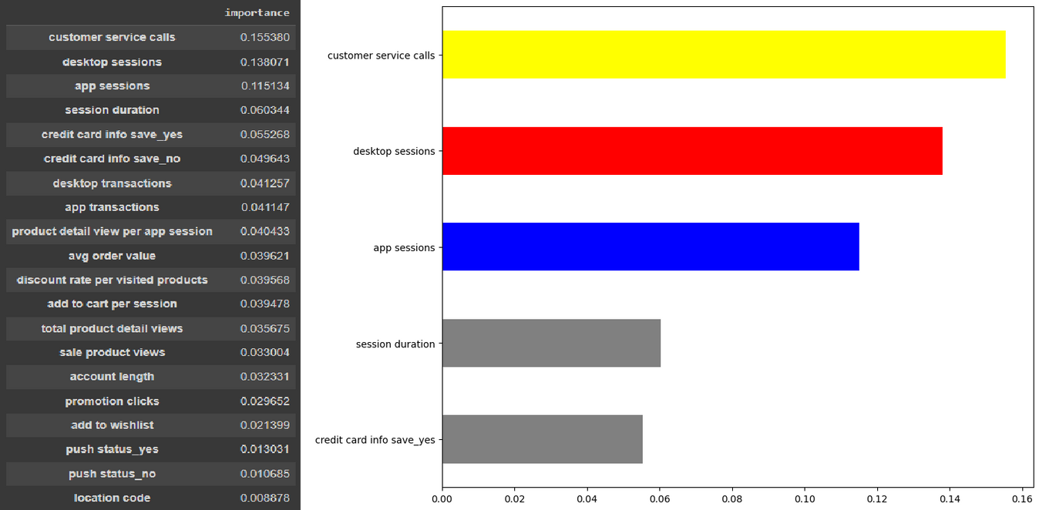
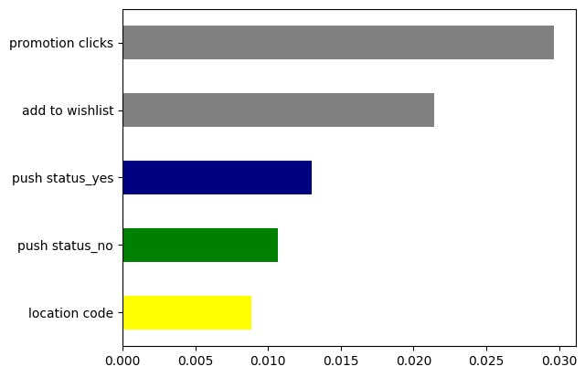
FEATURE IMPORTANCE BY RANDOM FOREST MODEL

Slide 27
RECOMENDATION
07

Slide 28

CUSTOMER CHURNS WHO HAVE MORE CONTACTS WITH CUSTOMER SERVICE
Organize follow-up training for employees to improve the ability to thoroughly solve customer problems, conduct a satisfaction survey.
Improve purchase policy and special benefits, vouchers suitable for customers who call many times reduce the possibility of customers leaving.

Slide 29


DIFFICULTIES OF CUSTOMERS IN MAKING PURCHASING DECISIONS
Proposing customers to buy to membership cards to receive incentives quickly and increasingly promote customer decision- making
Push notifications for Promotional Order in Customer’s Cart.
Create time or quantity-limited urgency for high-throughput or add-to-cart procducts.

Slide 30
THE END
THANKS FOR WATCHING

